Slide 1
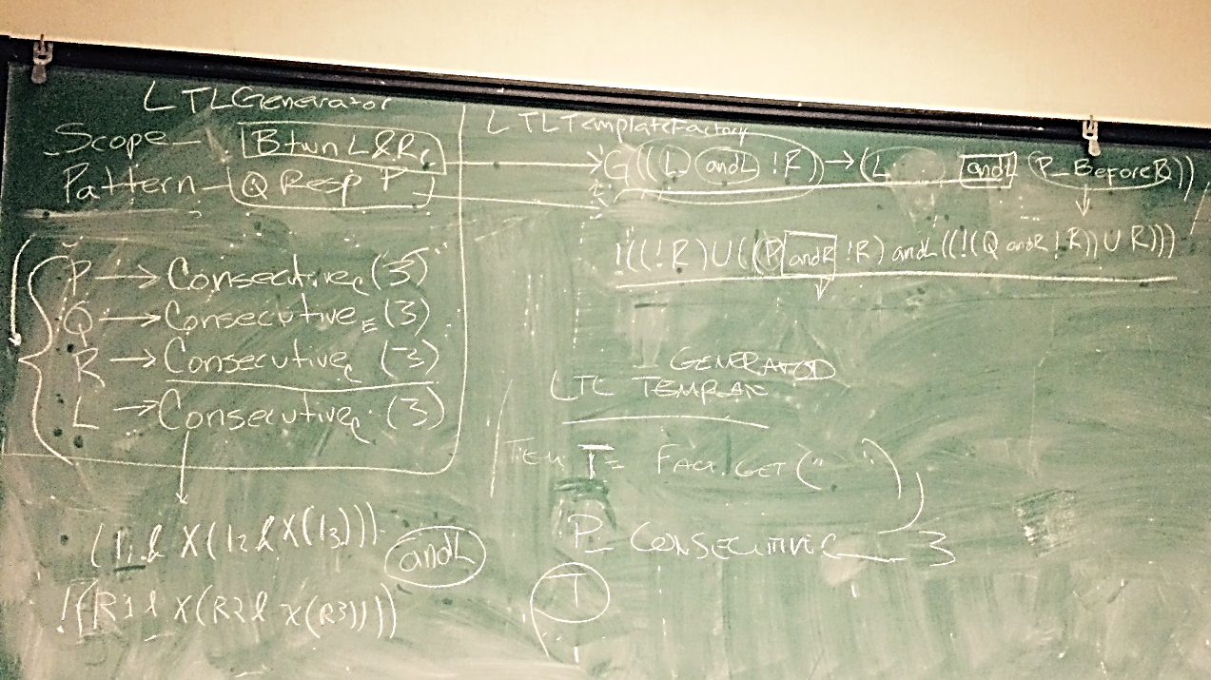
Roberto E Fierro

Slide 2
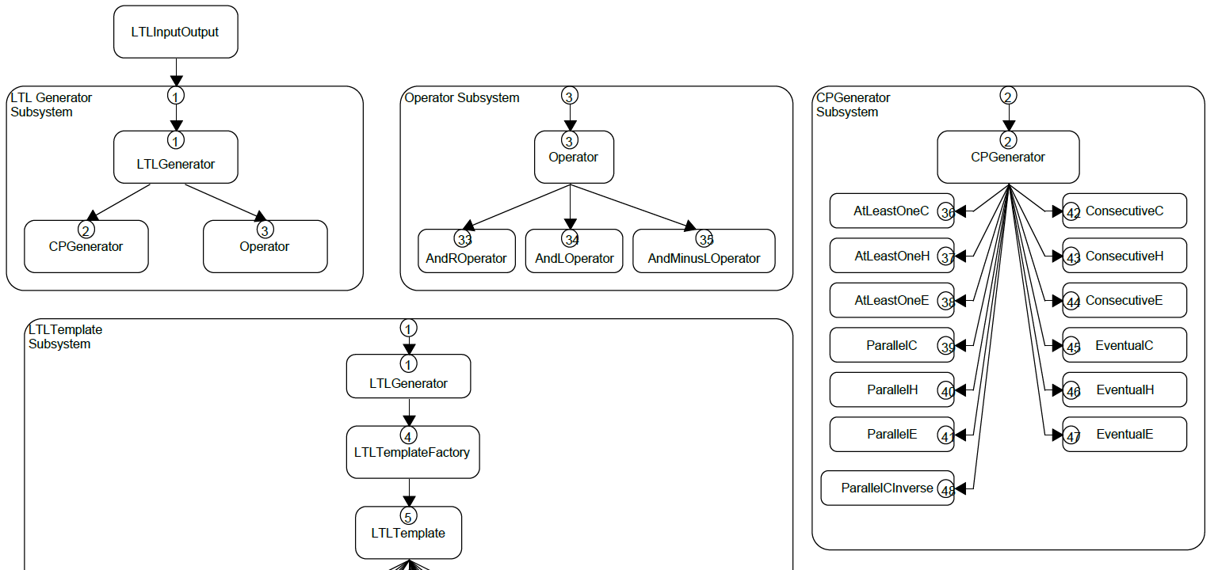
Subsystem/Contract Diagram

Slide 3
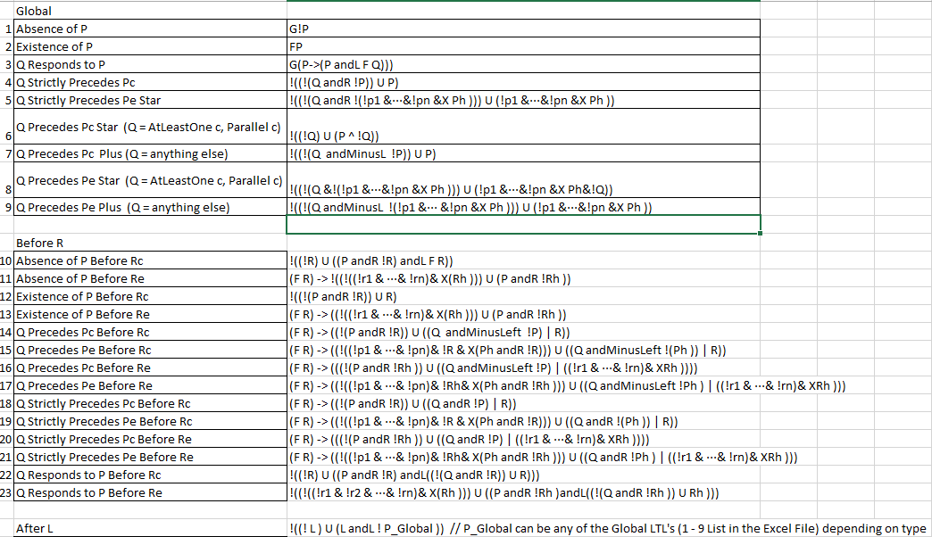
Parsed Scope & Pattern Formulas

Slide 4
Global Scope Implementation
Q Precedes Pc
Q Precedes Pc*
Q Precedes Pc+
getGlobalPrecedesPC
* or +
Unit Testing
Refactorings

Slide 5
Before R Scope Implementation
Absence Of P Before Rc, Re
Q Responds to P Before Rc, Re (AndL)
Q Precedes Pe Before Rc, Re (AndL)
AndL Operation
Unit Testing
Refactorings

Slide 6
LTL Generator Abstract Factory Implementation
LTL Generator Factory
Global Factory
Before R Factory
After L Factory
Between L And R Factory
After L Until R Factory
LTL Scope Type, and LTL Pattern Type Enums
Unit Testing

Slide 7
LTL Input Output Implementation
LTL Input Output
Process Input
Output To File
Unit Testing
Refactorings

